Slide 1
Religion and Peace
Ekkardt Sonntag, PhD – ekkardt.Sonntag@hu-berlin.de

Slide 2
Outline
History in Spotlights
Definitions
Conflict Mediation in Middle Eastern Sociological Perspective
Interreligious Dialogue

Slide 3
History in Spotlights
Iranian Revolution 1979
End of the Cold War 1991
9/11 2001
Afghanistan War / Iraq War
UN Resolutions on Interfaith Dialogue: 58/128, 59/23, and 61/221 (2003, 2004, 2006 respectively)
Obama Administration from 2009
Adapted from Hayward, Susan. 2012. ‘Religion and Peacebuilding Reflections on Current Challenges and Future Prospects’. United States Institute of Peace

Slide 4
Definitions - Religion
Religion as Set of Ideas
Religion as Community
Religion as Institution
Religion as Set of Symbols and Practices
Religion as Spirituality
Adapted from Frazer, Owen, and Mark Owen. 2018. ‘Religion in Conflict and Peacebuilding - Analysis Guide’. United States Institute of Peace.

Slide 5
Definitions - Peace
Positive / Negative Peace (Johan Galtung)
Peace in Abrahamic Tradition: S-L-M
“Peace in Islam is understood as a state of physical, mental, spiritual, and social harmony, living at peace with God through submission, and living at peace with one’s fellow human beings by avoiding wrongdoing. Islam obligates its believers to seek peace in all [of] life’s domains. The ultimate purpose of Qur’anic revelation for Muslims is to create a peaceful and just social order.”
Abu-Nimer (2003) p60

Slide 6
 | PEACE | non-violence | justice | intergroup-relations | recipropcity | sustainability | charity | flourishing | …
RELIGION
Sets-of-ideas
Institutions
Communities
Symbols
Practices
Spirituality
…
-> Add method and delimitors (time, space, people group…)
“Intergroup-relations and religious institutions in a Northern-German town the 1990s: A Cultural-Anthropological approach”

Slide 7
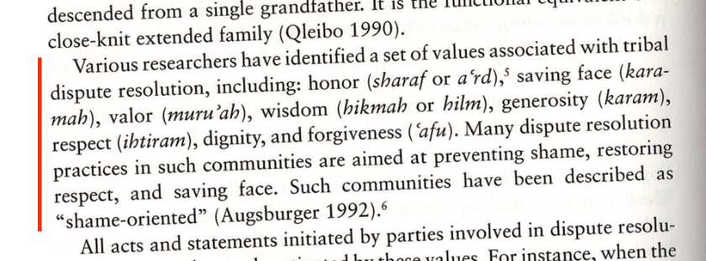
Conflict Mediation in Middle Eastern Sociocultural Context
Abu-Nimer 2003, Ch.3, p98

Slide 8
“A man’s/woman’s case is best presented by others.”
Richard Antoun, Institutionalized Deconfrontation, 1997

Slide 9
Arab Conflict Mediation: “Key Ingredients”
Initiation of Mediation
Avoiding Blood Revenge (Commitment)
Protective Custody (Enforcement)
Commitment to one Judicial Path
Negotiation
Guarantors
Reparations
Restoration

Slide 10
Social Paradigms
Guilt-Innocence
“What is right?” … according to a canon or standard
Shame-Honour
“What is honorable?” … according to the community or ‘court of reputation’

Slide 11
Interreligious Dialogue
Dialogue vs Dialecitc
Martin Buber: I-Thou (ich-du), I-It (ich-es)

Slide 12
Interreligious Dialogue: 3 Spotlights
Affective Dialogue
Cognitive Dialogue
Diapraxis

Slide 13
Affective Dialogue
“There is no pure dialectical dialogue. When two persons enter into dialogue, in spite of all attempts to keep the ‘personal’ to a bare minimum, it emerges all along. We never have an encounter of pure ideas” (Raimon Panikkar)

Slide 14
Cognitive Dialogue
Other words:
Doctrinal Dialogue
Scientific Dialogue
Dialogue of Truth
…
NEST: Dialogue of Truth for Life together

Slide 15
Interreligious Dialogue: 3 Spotlights
Affective Dialogue
Cognitive Dialogue
Diapraxis

Slide 16
Cognitive Dialogue: Exclusivism vs. Relativism
Exclusivism Only my truth is really true.
Relativism All “truths” are somehow true.
Look at exclusivism vs relativism as spectrum, not binary
Truth: true enough to matter, relative enough to be subject of discussion
Inhabitable space: grow language, concepts and relationships

Slide 17
“The power of theologies of interfaith cooperation is that they give us language that strengthens our connection with our faith, language deeply rooted in authentic interpretations of our holiest traditions, language that allows us to be both fully Christian or Jewish or Hindu and also fully in relationship with others.” Eboo Patel, Personal Theology (2018)
“Dialogue… is not a contribution to or a reflection on religious experience; it is religious experience.” Michael Anthony Barnes

Slide 18
Diapraxis
Lissi Rasmussen:
“Against the background of my experience in Africa and Europe, I see dialogue as a living process, a way of living in co-existence and pro-existence. Therefore I want to introduce the term “diapraxis”. While dialogue indicates a relationship in which talking together is central, diapraxis indicates a relationship in which common praxis is essential.”
‘Diakonia in Context | Transformation, Reconciliation, Empowerment’. 2009. The Lutheran World Federation. 1 January 2009. https://www.lutheranworld.org/content/resource-diakonia-context-transformation-reconciliation-empowerment.

Slide 19
M. Gopin. 2002. Holy War, Holy Peace How Religion Can Bring Peace to the Middle East, Oxford University Press.

Slide 20
Thank you!
Ekkardt.Sonntag@hu-berlin.de

Slide 21
Seminar

Slide 22
Dialogue on Values
Friendships | A clearly defined role | Freedom of speech | Appreciation | A net of social security | Care for nature
Responsibility for and engagement in society | To rule over your own life situation | Freedom of religion | Family | Material things | Quietness
Hospitality and visiting | Personal reputation, respect | The family’s honour | Influence on your own working situation | Rule of law | Equality
Community | Solidarity | Freedom | Honesty | Mercy | Creativity, play, joy of life
Development | Personal security | Wisdom of ancient times | Modesty | Care for others | Harmony
Beauty | Spirituality | Personal Integrity | Love | Religious practice | Justice

Slide 23
Solo Work:
Sort these 36 values into 2 lists:
A) 18 that you personally find more important
B) 18 that you personally find less important
From your List “A”, choose the top 10 in ranked order.
Group Work:
In your group, take turns and present your top 10 values, one by one.
Give a short explanation why this value is important to you. The group listens and does not judge or comment. Only comprehension questions.
As a group, try to agree on your top 10 values. Discuss, do not vote.

Slide 24
 | PEACE | non-violence | justice | intergroup-relations | recipropcity | sustainability | charity | flourishing | …
RELIGION
Sets-of-ideas
Institutions
Communities
Symbols
Practices
Spirituality
…
-> Add method and delimitors (time, space, people group…)
“Intergroup-relations and religious institutions in a Northern-German town the 1990s: A Cultural-Anthropological approach”

